Slide 1
Hello world
Lesson 00

Slide 2

Me

Slide 3
My goals
Better projects
Outside world sneak
Have fun

Slide 4
GIT
Lesson 01

Slide 5
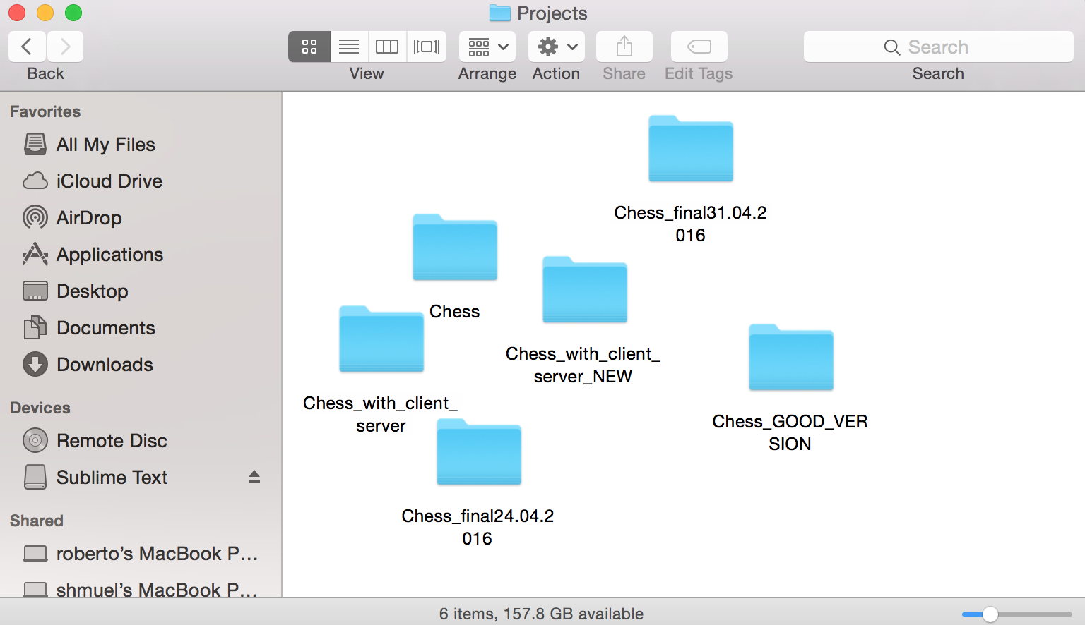
What the hell?!

Slide 6
Source control to the rescue!

Slide 7
Source control
Keep track all the changes in a project
Work together on the same project
Tag versions
Separate development branches

Slide 9
Linus Torvalds
Developer of:
Linux
GIT

Slide 10
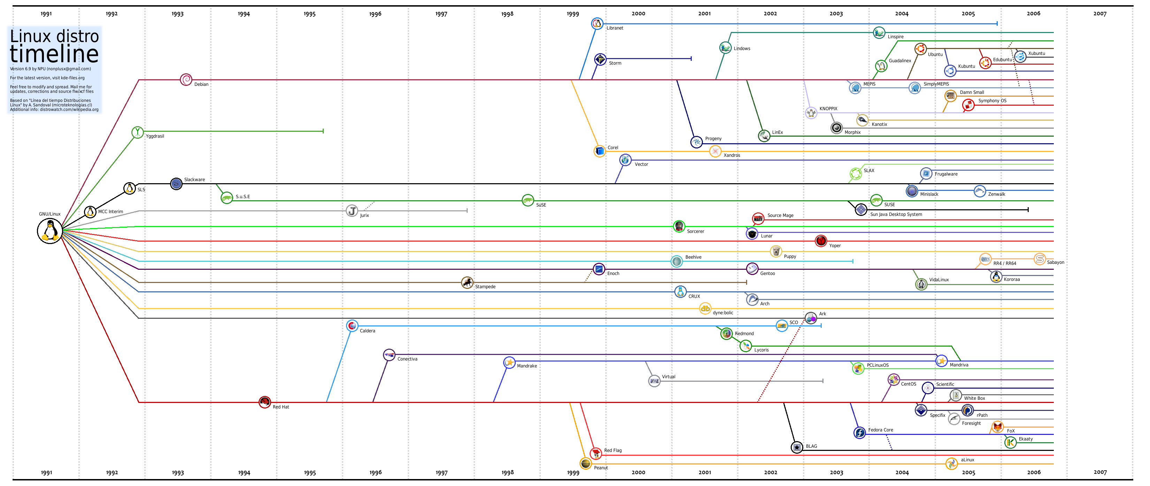

Slide 11
What is GIT?
Source control

Slide 12
GitHub

Slide 13
Demo

Slide 14
How to continue
Install GIT: https://git-scm.com/download/win
Install SourceTree: https://www.sourcetreeapp.com
Create a GitHub account: https://www.github.com
Clone https://github.com/shlomibs/AnatolyProjects.git into a local directory, in c:\Projects. – From SourceTree or from CMD
Inside c:\Projects\AnatolyProjects, create a directory in your name
Inside the directory, create a README.md file. Leave it empty for now.
IF YOU HAVE REACHED SO FAR, STOP AND CALL THE TEACHER BEFORE THE NEXT STEP
Commit your changes to a new branch. Branch name = your name
Push your changes

